Slide 1
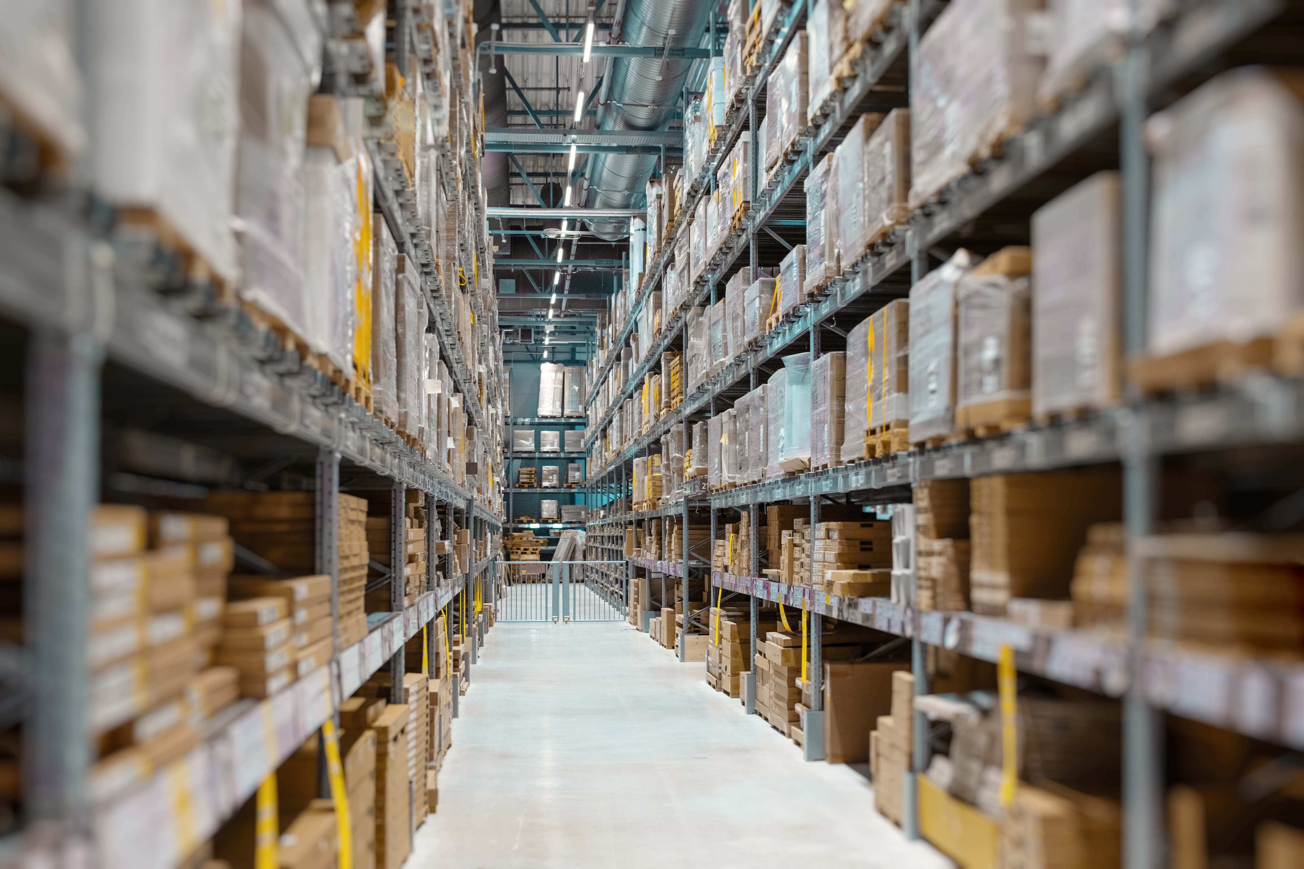
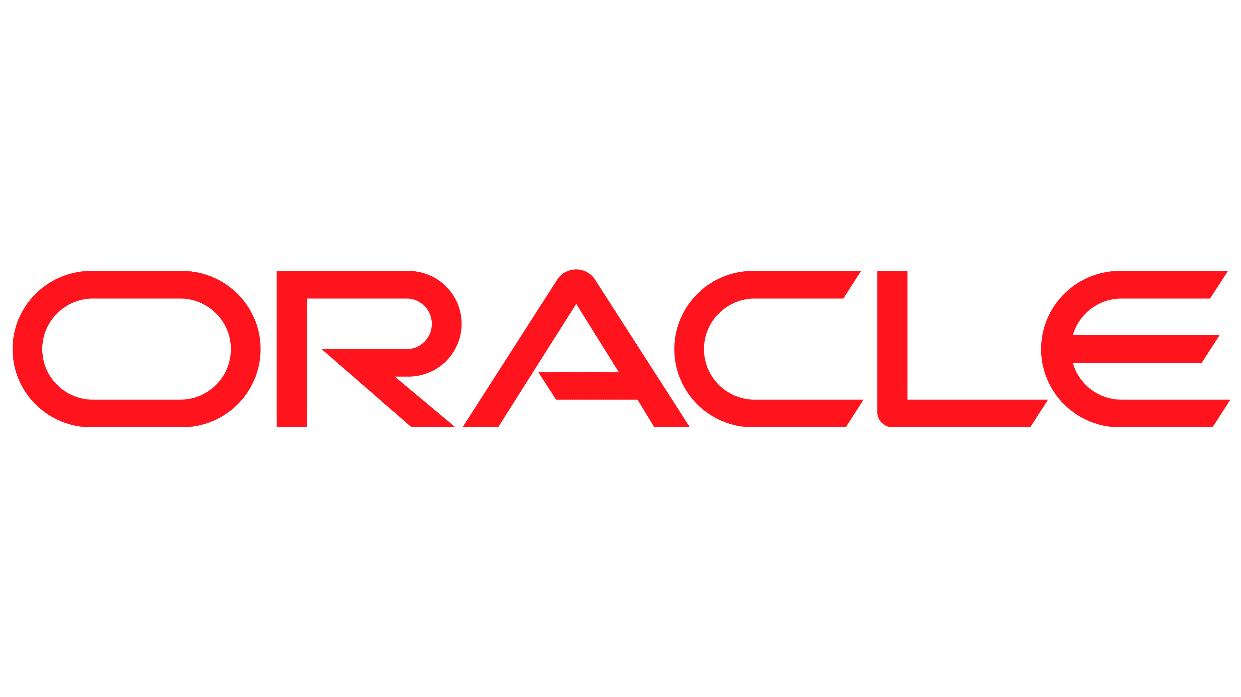



Supply Chain Management Track
Project Proposal

Slide 2





Team
“Team Leader”
Aly Hosni
BIS Student
Abdulrhman S. Elfeky
Energy Eng. Student
David Safwat
BIS Student
MennaTallah Hisham
BIS Student
Nouran Ayman
BIS Student

Slide 3

Project Outlines
Project Objectives:
Market Selection: Identify and define the target market that aligns with our business goals and strategic vision.
Business Model Framework: Develop a foundational business model structure that outlines our business process.
Organizational Hierarchy: Design a clear and efficient hierarchical structure to define roles, responsibilities, and reporting relationships within the organization.
Supply Chain Digitalization & Implementation: Analyze and justify our supply chain flow, providing a comprehensive overview of its components and functionality. Additionally, outline our strategy for implementing and optimizing the supply chain using Oracle ERP solutions to ensure efficiency and scalability.

Slide 4

Our Market
We Chose Fashion Retail Market
Why?
Complex Network: The fashion retail supply chain manages raw materials, production, and product distribution.
Key Stages: Includes fabric sourcing, garment manufacturing, quality control, inventory management, and logistics. (We will focus on RETAILING)
Speed & Flexibility: Essential to meet rapidly changing trends and consumer demands.
Cost Efficiency: Optimizes resources to reduce costs.
Competitive Edge: Effective management helps retailers stay competitive in a global market.

Slide 5

Our Firm
We created a scenario by
establishing a company called VDEL.
VDEL offers eco-friendly clothing made from sustainable materials, prioritizing fair labor, renewable energy, and minimal, recyclable packaging. The brand promotes circular fashion, encourages garment recycling, and builds customer trust through transparency and education.
VDEL
Fashion House
Notes:
-- > Add

Slide 6

Why ERP?
Digitalization of Our Business Using ERP
Efficiency: Automation streamlines inventory, order processing, and logistics, reducing errors and delays.
Centralized Data: Real-time access to inventory and supplier data ensures transparency and consistency.
Scalability: Easily adapts to growing production demands and expanding networks.
Cost Reduction: Minimizes errors, optimizes resources, and cuts logistics and administrative costs.
Collaboration: Integrated data enhances coordination between procurement, production, and logistics teams.

Slide 7

Challenges Will Solved
• Inefficient Inventory Management: ERP system will introduce real-time inventory tracking and automated alerts.
• Lack of Data for Decision-Making: Centralized data in an ERP system provide insights for strategic planning.
• Limited Customer Insight: ERP-enhanced CRM tools enable better customer engagement and targeted promotions.
• Financial management Inefficiencies: ERP automation ensures accuracy , and better financial visibility.
• Poor Collaboration across departments : A centralized ERP platform will enhance communication between all departments.

Slide 8
SCM Applications
Oracle Procurement: Streamlines sourcing sustainable materials like organic cotton and recycled fabrics by automating purchase orders and procurement workflows, ensuring timely restocking .
Oracle Inventory Management: Tracks our inventory across VDEL operations in real-time, preventing stock imbalances and supporting better management of seasonal and high-demand items.
Oracle Order Management: Enhances the order fulfillment process for both online and in-store channels, ensuring faster, more accurate handling of customer orders, returns, and exchanges to boost satisfaction.

Slide 9

Sales System
1. Sales Order Creation:
o Customers place orders through sales representatives.
o Orders are categorized based on store locations (e.g., Zamalek , Montaza).
2. Inventory Check
If item not available in the Showing Room:
o Verify stock availability in the respective Store WH (Warehouse).
o If stock is unavailable, trigger replenishment from the Main Inventory ORG (Cairo/Alex).
3. Order Fulfillment
o Goods are picked from the Finished Goods Locator in the store warehouse.
o If items are unavailable at the store level, they are sourced from the main inventory.
4. Invoicing and Payment
o Generate invoices through the ERP system.
o Update financial records in the General Ledger (Egypt).
5. Returns Management
o Process customer returns through the Returns Locator in each store WH.

Slide 10

Procurement
Identify Requirements Monitor stock levels in Store WH and Main Inventory ORG. Use minimum stock level triggers for reordering.
Purchase Requisition Store managers raise requisitions for restocking. Approved requisitions by the operating unit are forwarded to the procurement team.
Supplier Selection and PO Creation Select approved suppliers. Issue Purchase Orders (PO) with delivery instructions (Cairo/Alex warehouses).
Goods Receipt Receive materials at Receiving Area WH (Cairo/Alex). (Physically each WH is following to the main inv. they have, but on the system, Both are following to the main inv. Org in Cairo) Inspect and record received goods.
Stock Transfer to Stores Allocate goods to respective store warehouses based on demand.
Invoice Verification and Payment Match supplier invoices with POs and delivery receipts. Process payments.

Slide 11

Pricing System
Costing Strategy: Average .
Cost Calculation Method: Use the Average Cost method for inventory valuation. Every time new stock is received, recalculate the average cost of each item.
Cost Allocation: Costs are allocated across Inventory Organization . Costs for each store are updated dynamically based on average cost calculations.
Periodic Review: Perform monthly costing reviews to ensure alignment with the general ledger.

Slide 12


Supply Chain Structure From Business Perspective
VDEL Company
VDEL Management

Slide 13

Supply Chain Structure From Business Perspective
VDEL Management
Main Inventory
“Cairo”
Finished Good warehouse
Returns warehouse
Assets warehouse
Main Inventory
“Alex”
Finished Good warehouse
Returns warehouse
Assets warehouse
Notes:
وضح الفرق بين البينيس والسيستم

Slide 14




Supply Chain Structure From Business Perspective
We Have 2 end stores Each one have
Showroom
Storage “ASSET” “FG” “RETUERNS”

Slide 15
Supply Chain Structure From Business Perspective
STORE “Zamalek”
STORE “Montaza”

Slide 16
Chart of account
Charts of Account in Vdel Company Contains 5 Segments:
Company
Department
Account
Employee
Future 1
Example of chart of account :
1.80.70.123.01
Notes:
قلل الكلام اللي على اليمين :" 1 = Express Vedel Company
80 = Express Which Department is come from the Transaction(E.g Sales Department)
70 = Express the Account Who pay the Cost of this Transaction
123 = Express which Employee who make a transcation (E.g Ahmed)
01 = Express segment of future 1
02= Express segment of future 2

Slide 17
FlexField Qualifiers
FlexField Qualifier | Segment
Balancing Segment | Company
Cost Center | Department
Natural Account | Account

Slide 18
“System Structure Explanation”
VDEL Company
“Business Group”
General Ledger: Egypt
Legal Entity
Main Inventory ORG
“Cairo”
Finished Goods WH.
Returns WH.
Assets WH .
Main Inventory ORG
“Alex ”
Finished Goods WH.
Returns WH.
Assets WH .
VDEL Operating unit
STORE (Sub inv) “Zamalek”
Show Room Locator
Store Locator
STORE (Sub inv) “Montaza”
Show Room locator
Store Locator
Notes:
Costing.. Sales.. Procu..

